Slide 1

T-Mobile 4G-LTE
Student’s Name
Institutional Affiliation
Notes:
This presentation will tackle briefly T-Mobile 4G-LTE as the newest product in the past 12 months.

Slide 2
New Product
4G-LTE is one of the 4G technology that is currently known for its best performance and high speed.
All users of tablets or smartphones are advised to use 4G-LTE as it is only the best data choice in the market (Afrin & Mir, 2017). When comparing 3G and 4G-LTE, it is almost 10 times more faster thus giving it quite noticeable speed.
Another thing with 4G-LTE is its strength signal and also the recommendable network load. Using the 4G-LTE on your phone is as the same as using it on your home computer which is connected to a more improved wireless broadband network.
Notes:
Looking at the current situation, 4G-LTE is one of the most recommendable 4G technology which is appraised for its high speed and best performance. For that reason, the tablets and smartphone users are competing at the same ground and at other times smartphones are even better than a home computer connected to a wireless network. Research has shown that 4G-LTE is almost 10 times faster than 3G in terms of speed. Consequently, the strength of 4G-LTE is incomparable since it has the most advisable network load.

Slide 3
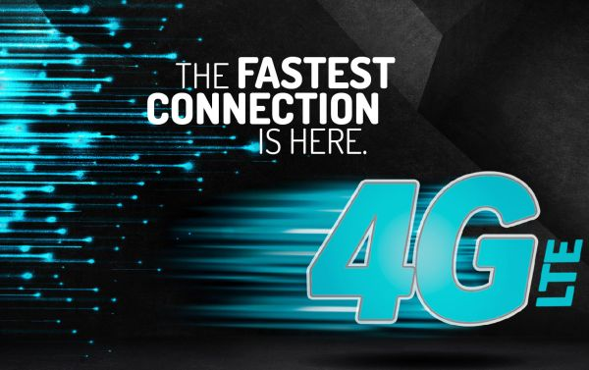
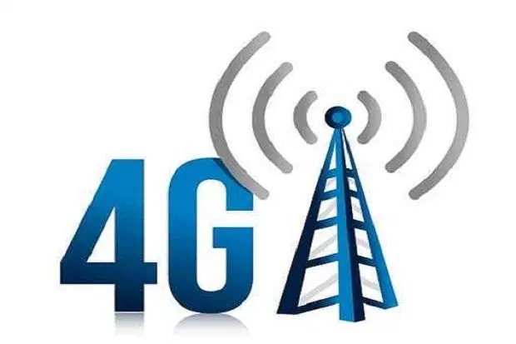
Importance of R&D
The significance of R&D in including market research and users is the 4G-LTE product alternatives that all revolve about excellence, reliability, speed and functionality (Backholm et al., 2017).
Notes:
The importance of R&D is unmeasurable since 4G has some alternatives to consider such as excellence, reliability, speed and functionality which makes the internet package to be the best of all times as we speak now.

Slide 4
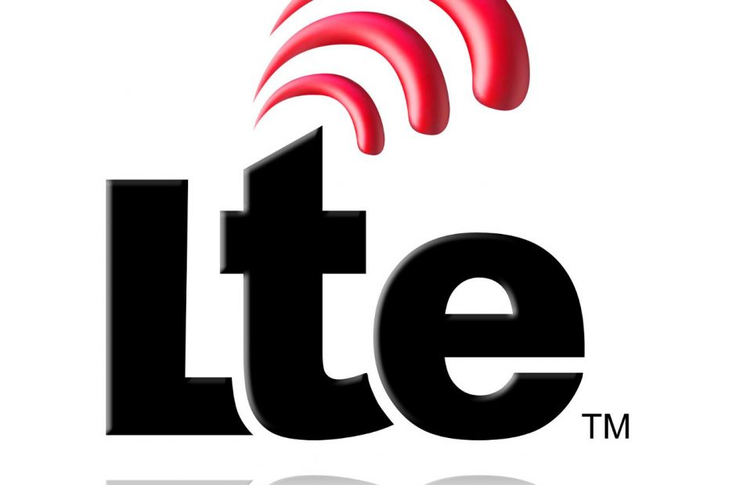
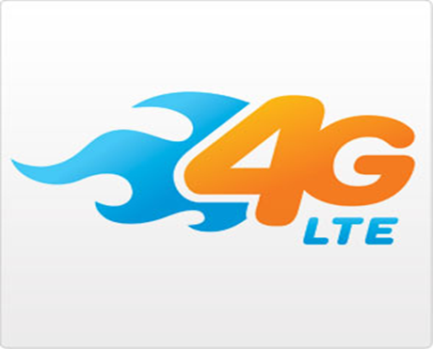
Appropriate Structure and Culture Necessary
Marketing of the 4G-LTE was given more support and thus this contributed to wide spread use of the data package to most of the users not only in the united states but also in the neighboring countries (Afrin & Mir, 2017).
Again, the various markets of extensive diversity were more devoted to 4G-LTE. However, for T-Mobile to penetrate the market and attract as many customers to use 4G-LTE as possible, they had to lower their prices with time.
Due to price reduction, China became one of the major markets for the 4G-LTE internet product which strengthened the company’s rate of competition.
Notes:
Giving more support to the marketing of 4G-LTE has facilitated its widespread not only in the united states but also to the neighboring countries. Also, extensive diversity of the various market have contributed a lot in attracting more subscribers and thus being able to penetrate the market appropriately. Consequently, through price reduction, 4G-LTE has gained wide market in China and hence increasing the company’s rate of competitiveness.

Slide 5
Future Inventions Inspired by the Product
A higher possibility of coming up with a more LTE-advanced which will bring in greater speeds.
According to Backholm et al. (2017), offer a clear path for implementation of Wi-Fi offload which will facilitate to transfer fast download to all the nearby Wi-Fi access points.
Notes:
4G-LTE has a high potential to inspire a number of future inventions. One of the possible future invention of 4G-LTE is introducing a more advanced LTE which will be accompanied with greater speeds. Secondly, there is a possible implementation of a Wi-Fi offload that will enhance a fast download to all the nearby Wi-Fi access points.

Slide 6
Product Demand in Five Years
The 4G-LTE product is likely to garner massive sales in the next five years (Afrin & Mir, 2017). It is estimated that in the next five years around 75 million subscription of the product will be experienced.
Most of the forecasters in the mobile network industry have speculated that there will be an extra 45 million mobile internet users by 2050.
Notes:
The demand for the 4G-LTE is likely to increase in the next 5 years. It has been estimated that around 75 subscribers are to come in and enjoy the services. This will give much support to the product in most parts of the continent. Again, mobile internet users are expected to increase by 45 million by 2050. This will tend to boost the mobile network industry to a greater extent.

Slide 7
References
Afrin, S., & Mir, T. (2017). Throughput Analysis of Various Fading Propagation Models used in 4G LTE System (Doctoral dissertation, East West University).
Backholm, A., Agarwal, V., Ren, A., Gupta, A., & Bott, R. (2017). U.S. Patent Application No. 15/488,827.

